Slide 1


House Prices
Predict the sales price for each house.
Student(s):E.M, O.A, B.M, V.P & A.SH Profesor: Gëzim Sejdiu
www.universum-ks.org
DATE: 08.01.2026

Slide 2

Agenda
The Problem
Dataset & Explore Data
Prepare Data
Features Identifying
Model Selection
Evaluate

Slide 3

The problem
The problem: Predict house sale prices from property features despite missing values, categorical variables, and skewed price distribution.

Slide 4
Dataset & Explore Data
Target: Sales Price
Train: 1,460 rows, 81 columns (includes target SalePrice)
Test: 1,459 rows, 80 columns
Mix of numeric (areas, counts, years) + categorical (zoning, neighborhood, condition)
Goal: predict sale price using feature engineering + tree-based models
Checked dataset shape, feature types (numeric + categorical), and basic summary statistics.
Audited missing values and identified columns where missing often means “Not available” (e.g., no basement/garage/pool).
Inspected the target (SalePrice) distribution — it is right-skewed, so we considered a log transform for modeling.
Used correlation / scatter plots to spot strong drivers (e.g., OverallQual, GrLivArea) and detect outliers.

Slide 5

Prepare Data
Removed non-informative identifiers (e.g., Id) and inspected columns with very high missingness.
Handled missing values using domain logic:
“Missing = not present” → filled with “None” for categorical amenities (basement/garage/fireplace, etc.).
Numeric quantities for absent features → filled with 0 (e.g., basement area when no basement).
Remaining categorical gaps → filled with mode (most frequent category).
Encoded categorical variables using one-hot encoding to convert them into model-ready features.
Split data into train/validation sets and ensured consistent preprocessing for both training and test data.

Slide 6
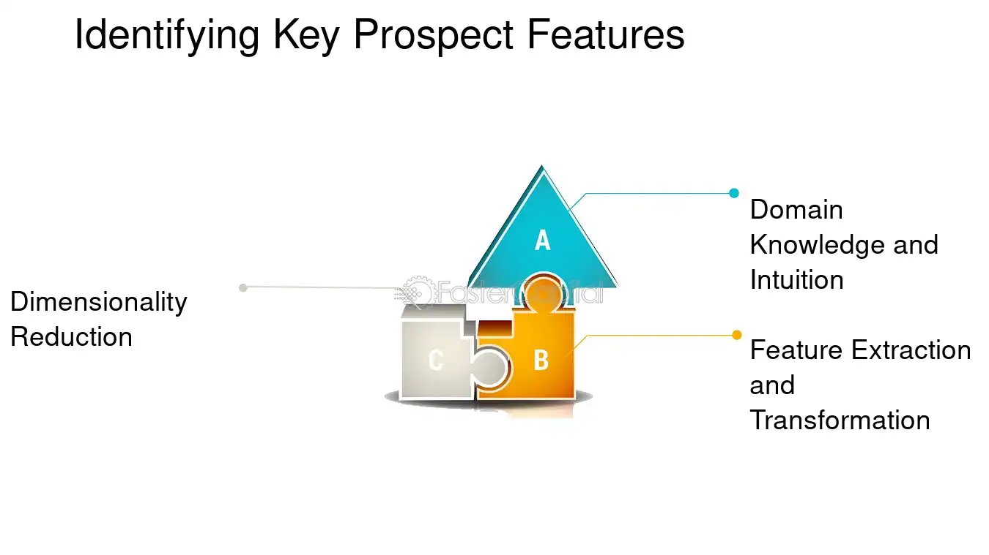
Feature Identifying
Reviewed all variables and grouped them into:
Numeric (areas, counts, years)
Categorical (neighborhood, style, zoning, quality ratings)
Identified the strongest predictive features using correlations and plots:
OverallQual, GrLivArea, TotalBsmtSF, GarageCars/GarageArea, YearBuilt
Flagged features with high missingness and clarified meaning of “missing” (often = no feature).
Detected potential outliers/influential points (e.g., unusually large living area) for careful handling in modeling.

Slide 7
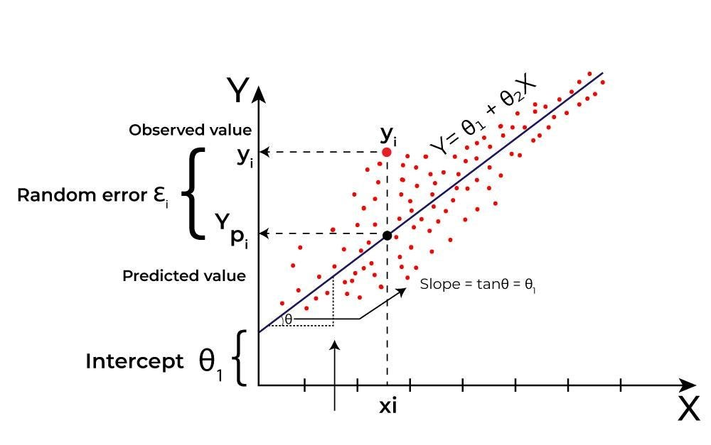
Model Selection
Started with a simple baseline to set a reference performance.
Chosen candidate models that handle non-linear relationships and feature interactions well.
Selected Gradient Boosting Regressor as the main model due to strong accuracy on tabular data.
Used cross-validation to compare models fairly and reduce overfitting risk.
Tuned key hyperparameters (e.g., n_estimators, learning_rate, max_depth, min_samples_leaf) using GridSearchCV.

Slide 8
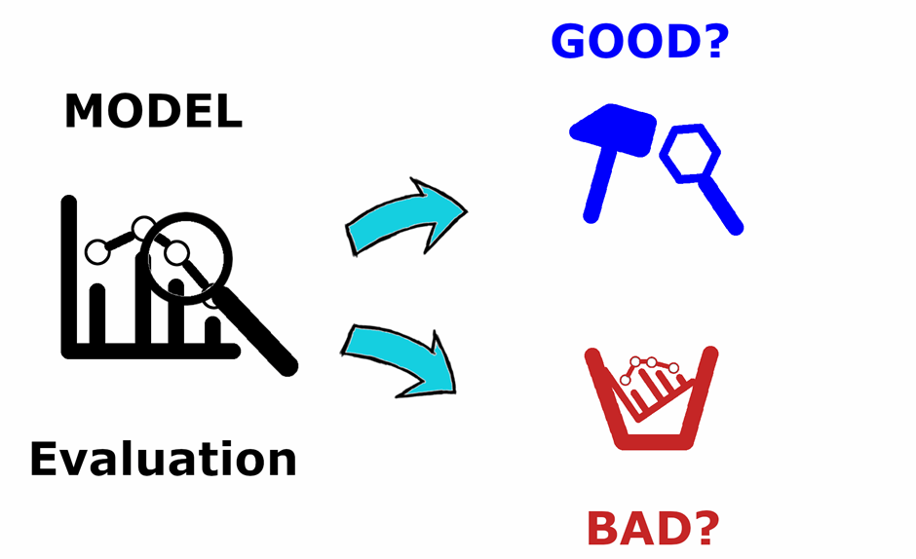
Evaluation
Used train/validation split plus k-fold cross-validation to estimate generalization performance.
Primary metric: RMSE on log(SalePrice) (reduces skew and penalizes large errors).
Checked model diagnostics with plots:
Predicted vs. Actual (should align close to the diagonal)
Residual distribution (should be centered around 0)
Verified the final pipeline works consistently on the test set and produced a submission-ready prediction file.

Slide 9
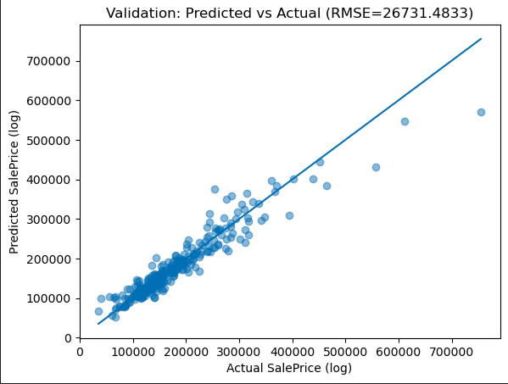
Results
Best CV RMSE (log): 0.134
Best model parameters (GradientBoostingRegressor):
learning_rate=0.01
max_depth=3
min_samples_leaf=5
n_estimators=800
Submission created: Predictions generated for 1459 test houses (matches test set size).

Slide 10
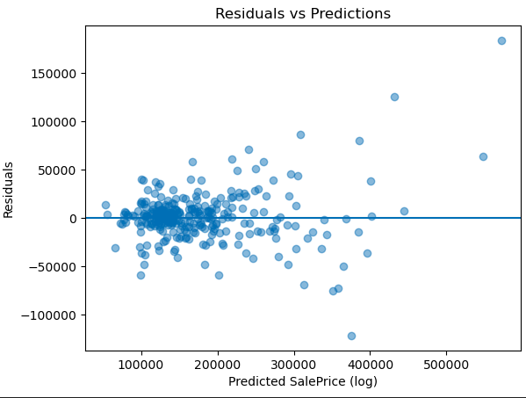
Results
Residual

Slide 11
Demo
Streamlit

Slide 12




THANK YOU
Kolegji Universum
universumcollege
universuminternationalcollege
info@universum-ks.org
www.universum-ks.org
DATE:

